Slide 1
AI Agents for Digital Capability Building in Tata Steel
SUMMER INTERNSHIP - 2026
WEEK-3
Build AI Core (Agentic + Practical Integration)
Under The Guidance of:
Mr. Abhinav Anish
Submitted By: Vaibhav Kumar

Slide 2
Objective: Build a basic AI agent capable of answering Learning & Development queries using organizational knowledge.
What is Agentic AI?
In Traditional chatbots the response it fetched by using a LLM layer in between the user query and response generated.
But the model cannot answer company related queries as it’s not trained on the company specific data.
The model only uses model knowledge used during training.
While in Agentic AI
The user submits a query.
The agent analyses the query and decides which tool or knowledge source is required.
The relevant information is retrieved from company documents, databases, or other tools.
The retrieved information is provided to the LLM as context.
The LLM generates a response grounded in company-specific data.

Slide 3
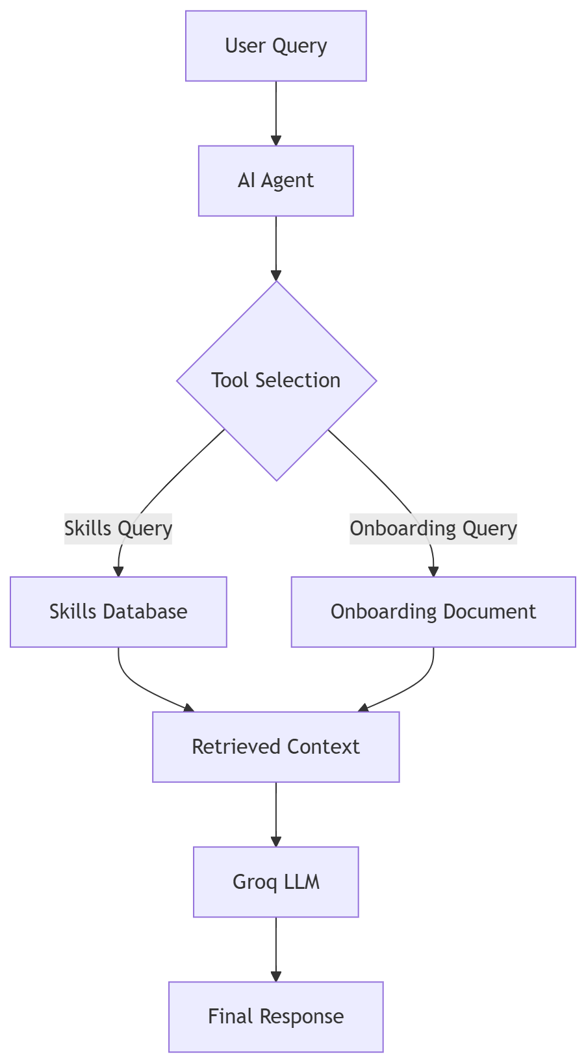
The Demo Architecture
How It Works:
User submits a query: Example: "What happens during the first 90 days?"
AI Agent analyses the query
The query is converted to lowercase.
The agent checks for keywords and phrases.
Tool Selection
If the query contains keywords like:
skills ,data analyst ,software engineer ,ai engineer
→ Agent selects Skills Database Tool
If the query contains keywords like:
onboarding ,salary ,benefits ,leave ,training ,90 days
→ Agent selects Onboarding Document Tool
Information Retrieval
Selected tool fetches relevant information from the CSV or onboarding document.
Context Generation
Retrieved information is combined with the user's question.
LLM Processing
Groq LLM uses the retrieved context to generate a relevant response.
Response Returned
Final answer is displayed to the user.

Slide 4
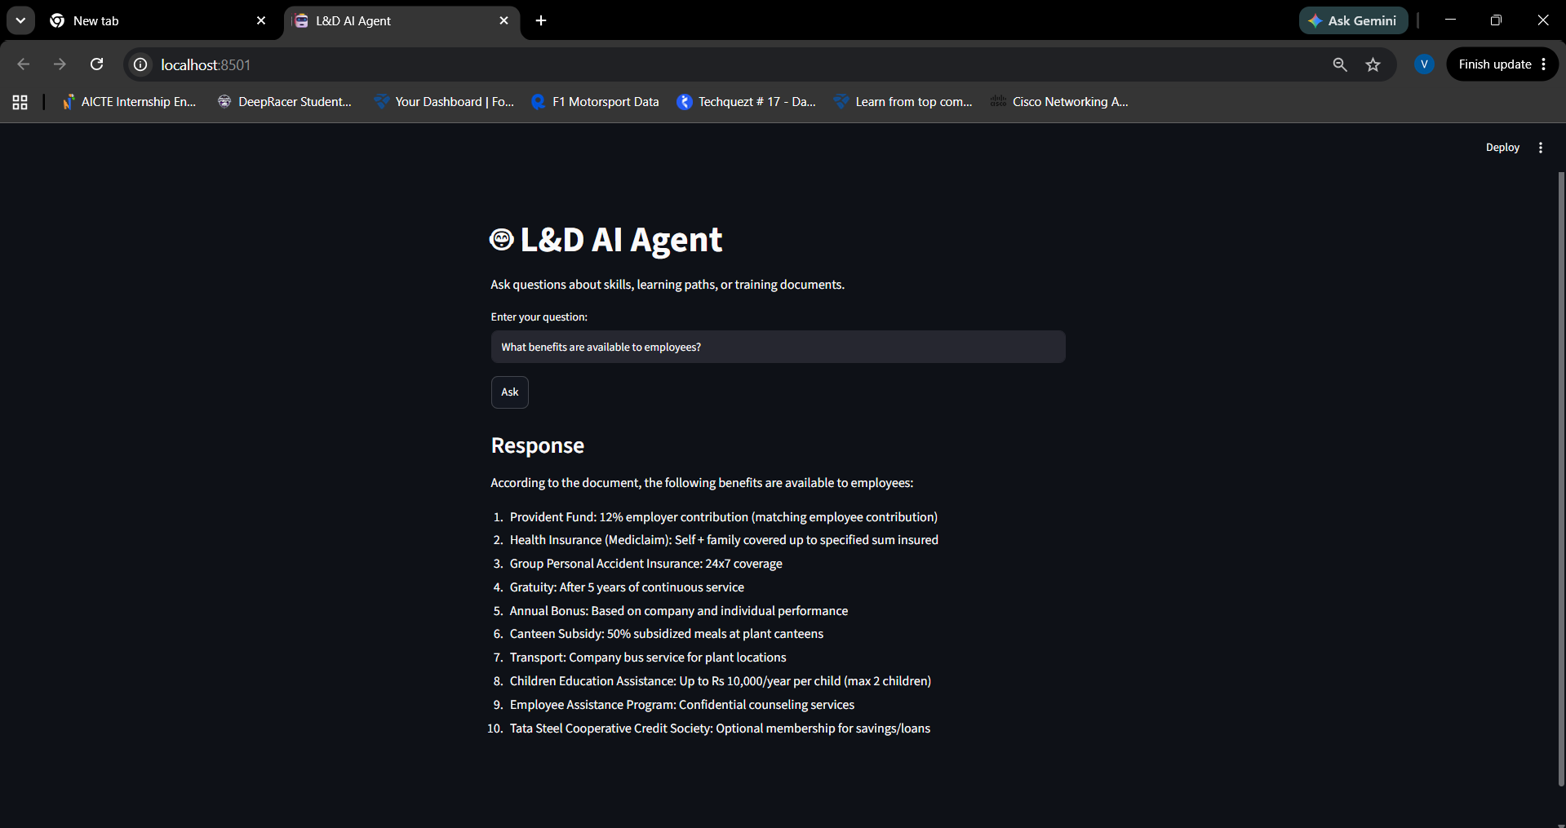
Demo Screenshot

Slide 5
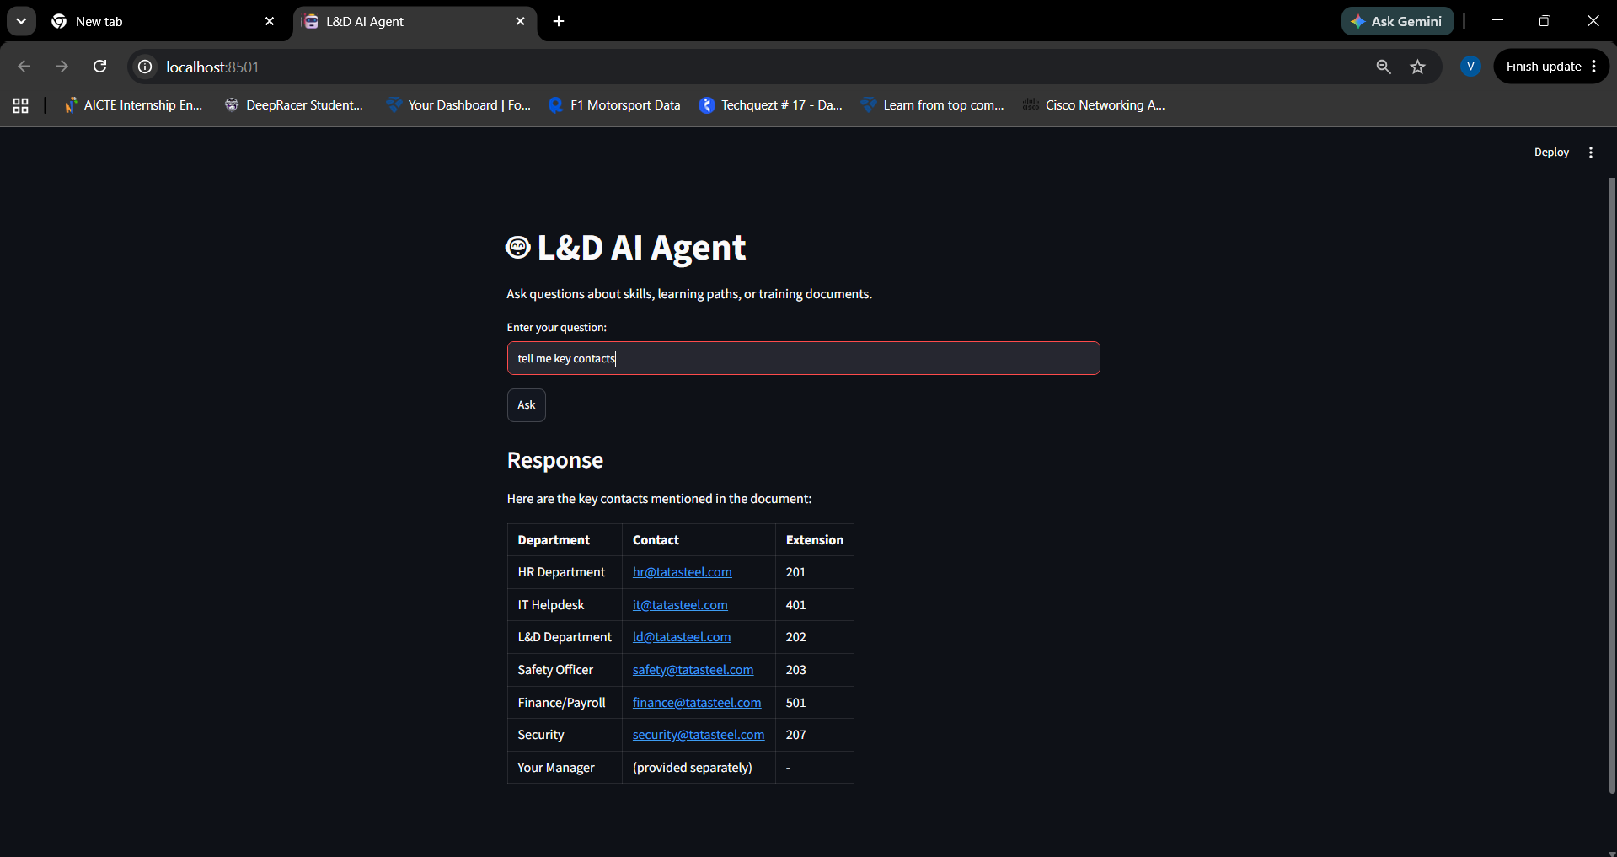

Slide 6
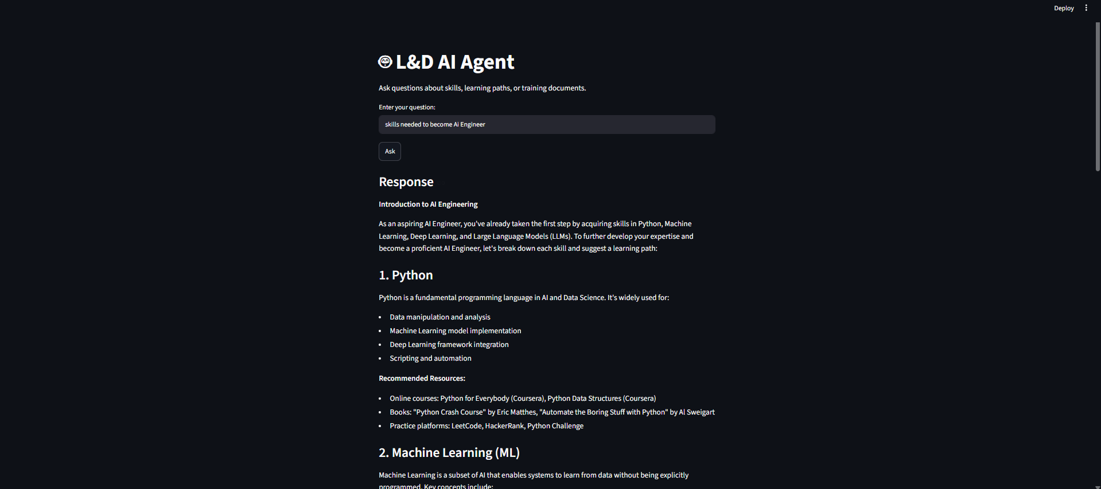

Slide 7
Drawbacks
There is a keyword dependency in this architecture:
Eg: When eill I get my first salary will be answered as “salary” will match.
When will I get paid first – this will fall back and make the default LLM run and give a general answer.
This results in poor scalability and limits the user to suing very specific words which is very unlikely.
The fix:
Replace keyword matching with an LLM-based router or semantic similarity-based tool selection for better scalability and accuracy.
GitHub Link:-https://github.com/VaibhavK762/L-D-agent-demo

